Slide 1
PART 3
Basic Branching, Looping & Function

Slide 2
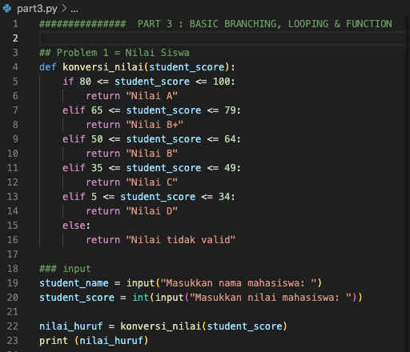
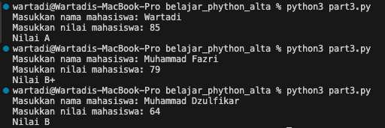
Problem 1 - Konversi Nilai
Input Program
Output Program

Slide 3
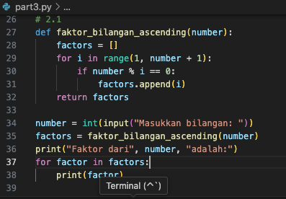
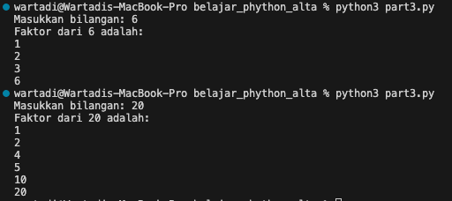
Problem 2 - 2.1 Faktor Bilangan (Ascending)
Input Program
Output Program

Slide 4
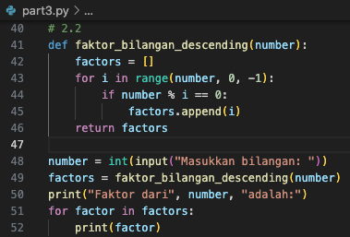
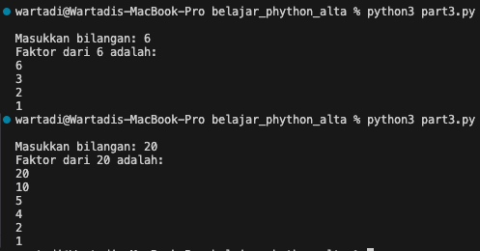
Problem 2 - 2.2 Faktor Bilangan (Descending)
Input Program
Output Program

Slide 5
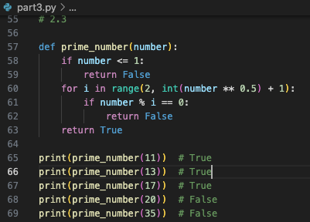
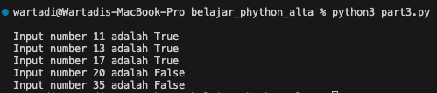
Problem 3 - Bilangan Prima
Input Program
Output Program

Slide 6
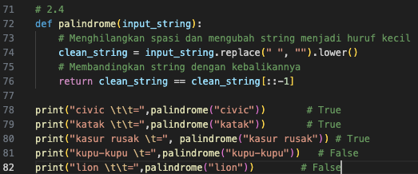

Problem 4 - Palindrome
Input Program
Output Program

Slide 7
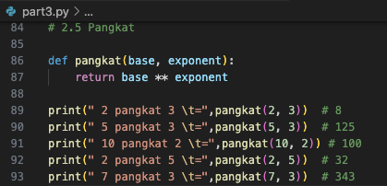
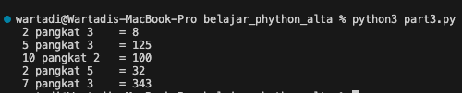
Problem 5 - Exponentiation
Input Program
Output Program

Slide 8
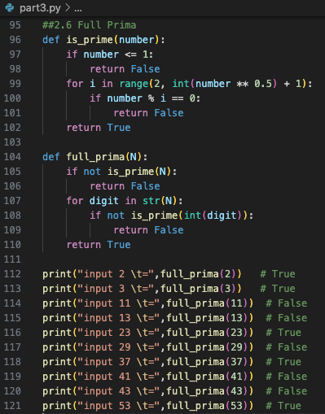
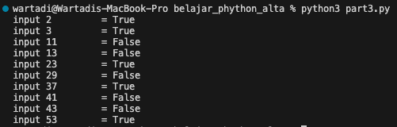
Problem 6 - Exponentiation
Input Program
Output Program

